Slide 1



Blinkit Sales Analysis
Empowering Business Insights through SQL Data Analytics
Notes:
1

Slide 2
Project Overview & Objectives
1
2
3
Project Scope
Core Objective
Impact
In-depth analysis of Blinkit sales performance.
Derive actionable business insights using advanced SQL queries.
Optimize sales, enhance customer satisfaction, and streamline inventory.
Notes:
2

Slide 3

Dataset & Data Cleaning
Dataset: Comprehensive Blinkit sales data, ready for analysis.
Example Transformation:
Cleaning Process:
Standardizing Item_Fat_Content
UPDATE blinkit_dataSET Item_Fat_Content = CASE WHEN Item_Fat_Content IN ('LF', 'low fat') THEN 'Low Fat' WHEN Item_Fat_Content = 'reg' THEN 'Regular' ELSE Item_Fat_ContentEND;
Handling missing values
Ensuring data consistency
Notes:
3

Slide 4
Business Requirements
KPI’s Requirements
Granular Requirements
Total Sales: Overall revenue.
Total Sales by Fat Content: Analyze impact of fat content on sales and KPIs.
2. Average Sales: Average revenue per sale.
3. Number of Items: Total count of items sold.
2. Total Sales by Item Type: Identify performance of different item types and their KPI variations.
4. Average Rating: Average customer rating.
3. Fat Content by Outlet for Total Sales: Compare total sales across outlets, segmented by fat content and KPIs.
4. Total Sales by Outlet Establishment: Evaluate how outlet age/type influences total sales.
Chart’s Requirements
1. Percentage of Sales by Outlet Size: Analyze correlation between outlet size and total sales.
2. Sales by Outlet Location: Assess geographic sales distribution.
3. All Metrics by Outlet Type: Comprehensive view of all KPIs broken down by outlet types.
Notes:
4

Slide 5
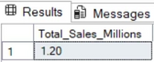
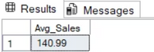
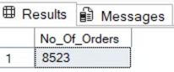
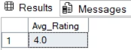
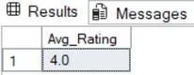
Strategic SQL Queries
Views were created for each KPI and granular requirement, enhancing data reusability and query simplification.
-- KPI’s Requirements--
Total Sales
CREATE VIEW Total_Sales ASSELECTCAST(SUM(Total_Sales) / 1000000 AS DECIMAL(10, 2)) AS Total_Sales_MillionsFROM blinkit_data;
SELECT * FROM Total_Sales;
-- Average Sales
CREATE VIEW Avg_Sales ASSELECTCAST(AVG(Total_Sales) AS DECIMAL(10, 2) ) AS Avg_SalesFROM blinkit_data;
SELECT * FROM Avg_Sales;
-- Number of Items
CREATE VIEW No_Of_Orders ASSELECTCOUNT(*) AS No_Of_OrdersFROM blinkit_data;
SELECT * FROM No_Of_Orders;
-- Average Rating
CREATE VIEW Avg_Rating ASSELECTCAST(AVG(Rating) AS DECIMAL(10, 1)) AS Avg_RatingFROM blinkit_data;
SELECT * FROM Avg_Rating;
-- Average RatingCREATE VIEW Avg_Rating ASSELECTCAST(AVG(Rating) AS DECIMAL(10, 1)) AS Avg_RatingFROM blinkit_data;SELECT * FROM Avg_Rating;
Complex queries were optimized for performance and clarity, including pivot tables for cross-segment analysis.
Notes:
5

Slide 6
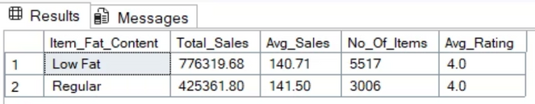
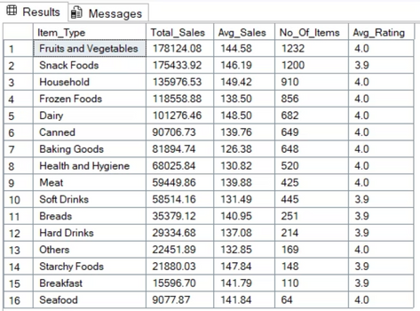
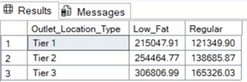
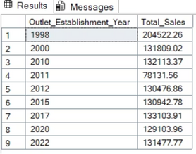
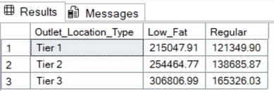
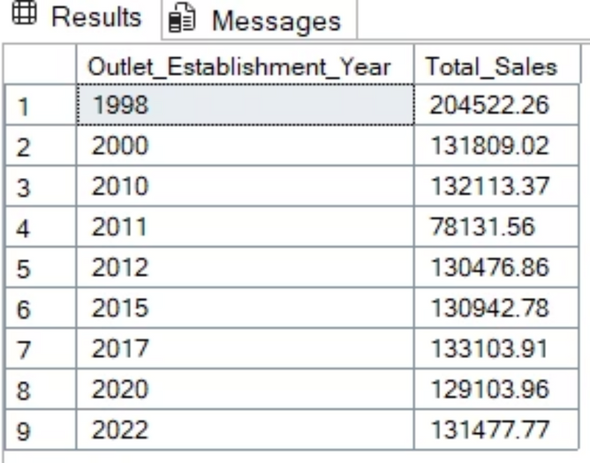
-- Granular Requirements--
Total Sales by Fat Content
CREATE VIEW Total_Sales_by_Fat_Content ASSELECTItem_Fat_Content,CAST(SUM(Total_Sales) AS DECIMAL(10, 2)) AS Total_Sales,CAST(AVG(Total_Sales) AS DECIMAL(10, 2) ) AS Avg_Sales,COUNT(*) AS No_Of_Items,CAST(AVG(Rating) AS DECIMAL(10,1)) AS Avg_RatingFROM blinkit_dataGROUP BY Item_Fat_Content;
SELECT * FROM Total_Sales_by_Fat_Content;
-- Total Sales by Item Type
CREATE VIEW Total_Sales_by_Item_Type ASSELECT Item_Type,CAST(SUM(Total_Sales) AS DECIMAL(10,2))AS Total_Sales,CAST(AVG(Total_Sales) AS DECIMAL(10, 2) ) AS Avg_Sales,COUNT(*) AS No_Of_Items,CAST(AVG(Rating) AS DECIMAL(10,1)) AS Avg_RatingFROM blinkit_dataGROUP BY Item_Type;
SELECT * FROM Total_Sales_by_Item_TypeORDER BY Total_Sales DESC;
-- Fat Content by Outlet for Total Sales
CREATE VIEW Fat_Content_by_Outlet_for_Total_Sales ASSELECT Outlet_Location_Type, ISNULL([Low Fat], 0) AS Low_Fat,ISNULL([Regular], 0) AS RegularFROM ( SELECT Outlet_Location_Type, Item_Fat_Content, CAST(SUM(Total_Sales) AS DECIMAL(10,2)) AS Total_Sales FROM blinkit_data GROUP BY Outlet_Location_Type, Item_Fat_Content) AS SourceTablePIVOT (SUM(Total_Sales)FOR Item_Fat_Content IN ([Low Fat], [Regular])) AS PivotTable
SELECT * FROM Fat_Content_by_Outlet_for_Total_Sales ORDER BY Outlet_Location_Type;
-- Total Sales by Item Type
CREATE VIEW Total_Sales_by_Item_Type ASSELECT Item_Type,CAST(SUM(Total_Sales) AS DECIMAL(10,2))AS Total_Sales,CAST(AVG(Total_Sales) AS DECIMAL(10, 2) ) AS Avg_Sales,COUNT(*) AS No_Of_Items,CAST(AVG(Rating) AS DECIMAL(10,1)) AS Avg_RatingFROM blinkit_dataGROUP BY Item_Type;
SELECT * FROM Total_Sales_by_Item_TypeORDER BY Total_Sales DESC;
-- Fat Content by Outlet for Total SalesCREATE VIEW Fat_Content_by_Outlet_for_Total_Sales ASSELECT Outlet_Location_Type, ISNULL([Low Fat], 0) AS Low_Fat, ISNULL([Regular], 0) AS RegularFROM ( SELECT Outlet_Location_Type, Item_Fat_Content, CAST(SUM(Total_Sales) AS DECIMAL(10,2)) AS Total_Sales FROM blinkit_data GROUP BY Outlet_Location_Type, Item_Fat_Content) AS SourceTablePIVOT ( SUM(Total_Sales) FOR Item_Fat_Content IN ([Low Fat], [Regular])) AS PivotTableSELECT * FROM Fat_Content_by_Outlet_for_Total_SalesORDER BY Outlet_Location_Type;
-- Total Sales by Outlet EstablishmentCREATE VIEW Total_Sales_by_Outlet_Establishment ASSELECT Outlet_Establishment_Year,CAST(SUM(Total_Sales) AS DECIMAL(10,2)) AS Total_SalesFROM blinkit_dataGROUP BY Outlet_Establishment_Year;SELECT * FROM Total_Sales_by_Outlet_EstablishmentORDER BY Outlet_Establishment_Year;
Complex queries were optimized for performance and clarity, including pivot tables for cross-segment analysis.
Notes:
6

Slide 7
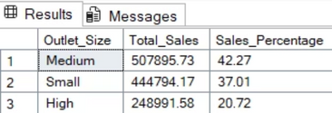
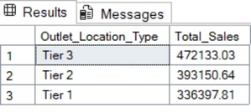
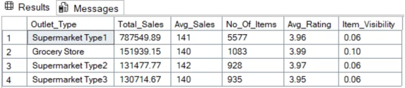
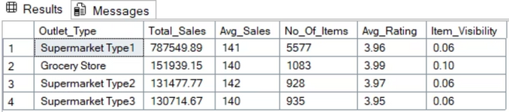
-- Chart’s Requirements--
Percentage of Sales by Outlet Size
CREATE VIEW Percentage_of_Sales_by_Outlet_Size ASSELECTOutlet_Size,CAST(SUM(Total_Sales) AS DECIMAL(10,2)) AS Total_Sales,CAST((SUM(Total_Sales) * 100.0 / SUM(SUM(Total_Sales)) OVER())AS DECIMAL(10,2)) AS Sales_Percentage FROM blinkit_data GROUP BY Outlet_Size;
SELECT * FROM Percentage_of_Sales_by_Outlet_Size ORDER BY Total_Sales DESC;
-- Sales by Outlet Location
CREATE VIEW Sales_by_Outlet_Location AS SELECT Outlet_Location_Type,CAST(SUM(Total_Sales) AS DECIMAL(10,2)) AS Total_SalesFROM blinkit_dataGROUP BY Outlet_Location_Type;
SELECT * FROM Sales_by_Outlet_Location ORDER BY Total_Sales DESC;
-- All Metrics by Outlet Type:
CREATE VIEW All_Metrics_by_Outlet_Type ASSELECT Outlet_Type, CAST(SUM(Total_Sales) AS DECIMAL(10,2)) AS Total_Sales,CAST(AVG(Total_Sales) AS DECIMAL(10,0)) AS Avg_Sales,COUNT(*) AS No_Of_Items,CAST(AVG(Rating) AS DECIMAL(10,2)) AS Avg_Rating,CAST(AVG(Item_Visibility) AS DECIMAL(10,2)) AS Item_VisibilityFROM blinkit_data GROUP BY Outlet_Type;
SELECT * FROM All_Metrics_by_Outlet_Type ORDER BY Total_Sales DESC;
Complex queries were optimized for performance and clarity, including pivot tables for cross-segment analysis.
Notes:
7

Slide 8
Sales Performance Highlights
$3.2M
$1,200
10K+
4.2
Total Sales
Average Sale
Items Sold
Average Rating
Overall revenue from all items.
Revenue per transaction.
Total count of unique items.
Customer satisfaction score.
Notes:
8

Slide 9

Key Insights: Product & Outlet Analysis
Low Fat Items: Contribute ~40% higher sales than Regular Fat.
Outlet Size: Medium-sized outlets generate ~45% of overall sales.
Top Categories: Snack Foods & Dairy drive the top 30% of total sales.
Location Impact: Tier 3 outlets contribute ~35% more revenue growth.
Outlet Type: Supermarket Type1 dominates sales; Type2 shows higher customer ratings (+15%).
Notes:
9

Slide 10
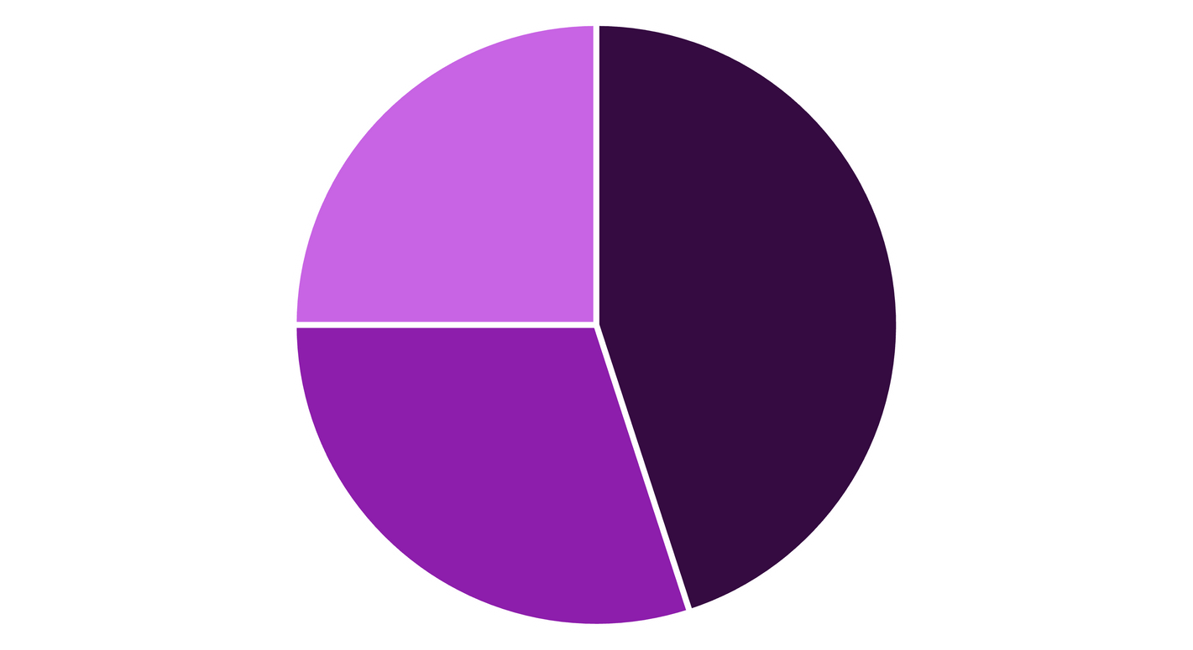
Sales by Outlet Size
Percentage of total sales by outlet size category.
Medium outlets are clear leaders, representing nearly half of all sales.
Medium
Small
Large
Medium outlets are clear leaders, representing nearly half of all sales.
Notes:
10

Slide 11



Impact of Data-Driven Recommendations
Inventory Optimization
Revenue Boost
Sales Efficiency
Projected improvement of 18-20%.
Potential 10% increase from item contribution insights.
Expected 12% boost by focusing on underperforming outlets.
Notes:
11

Slide 12
Conclusion & Next Steps
This SQL-driven analysis provides a clear roadmap for Blinkit to optimize sales, inventory, and customer satisfaction.
Key Takeaways:
Recommendations:
Fat content and item type significantly influence sales.
Focus on promoting low-fat and high-demand categories.
Outlet size and location are critical for revenue generation.
Strategically expand or optimize medium-sized outlets in Tier 3 locations.
Customer ratings offer valuable insights into outlet performance.
Leverage high-rated outlets' practices to improve others.
Notes:
12

